Slide 1
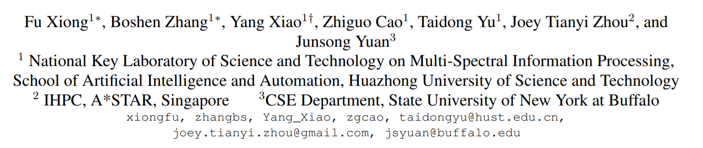
A2J: Anchor-to-Joint Regression Network for 3D Articulated Pose Estimation from a Single Depth Image
Boshen Zhang
2019,9,27

Slide 2
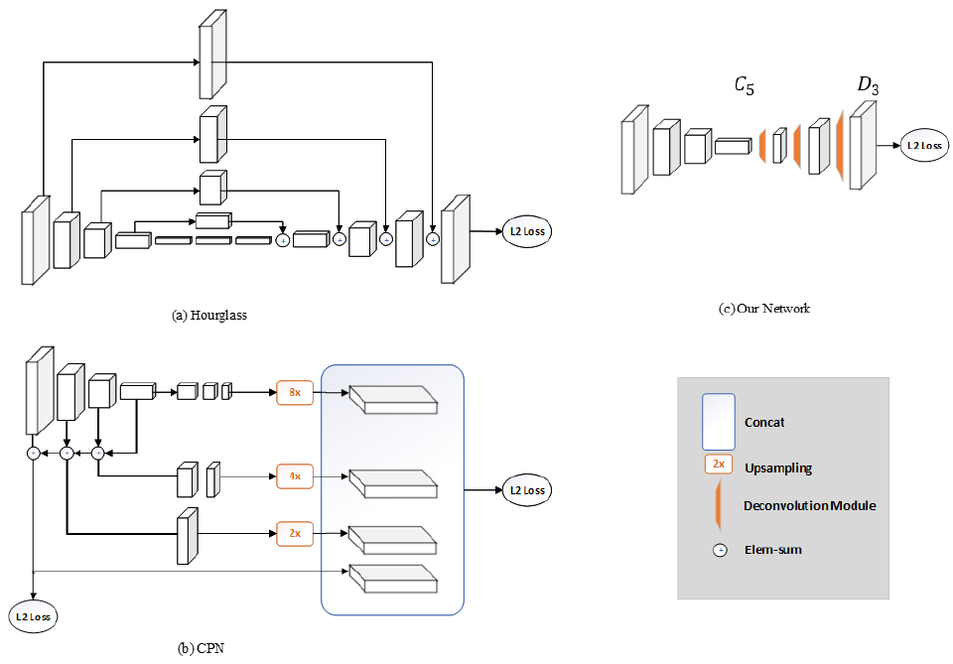
Introduction:
Previous SoTA (FCN (heatmap)-based methods):
Simple
Baseline [1]
[1] Simple Baselines for Human Pose Estimation and Tracking.

Slide 3
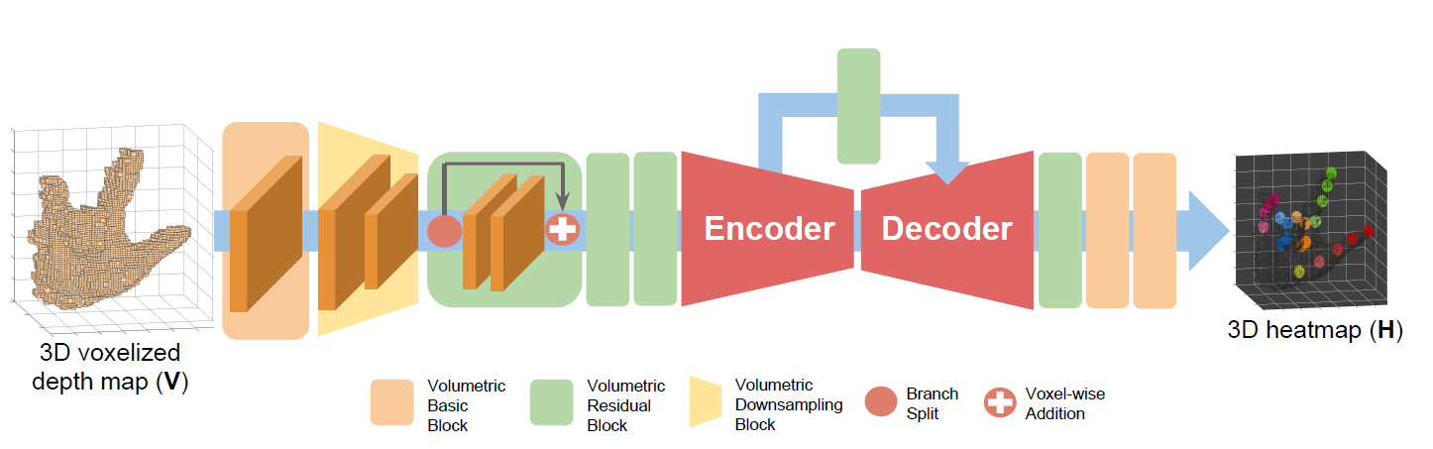
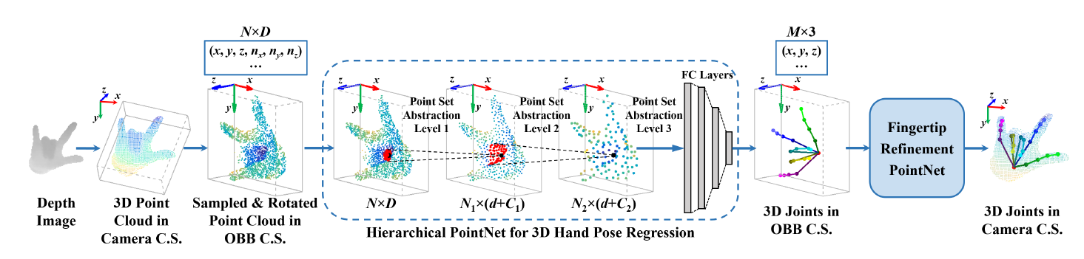
Introduction:
Previous SoTA (3D pose estimation methods):
V2V [2]
HandPointNet [3]
[2] V2v-posenet: Voxel-to-voxel prediction network for accurate 3d hand and human pose estimation from a single depth map.
[3] Hand pointnet: 3d hand pose estimation using point sets.

Slide 4
Motivation:
FCN (heatmap)-based methods:
Non-adaptive ground-truth Gaussian heatmap for different joints;
Time consuming deconv operation;
Cannot be fully end-to-end trained (most of them).
3D pose estimation methods:
3D CNN:
Costly voxelizing processing and 3D conv;
Point-set based methods:
Time-consuming preprocessing procedures (e.g., point sampling).

Slide 5
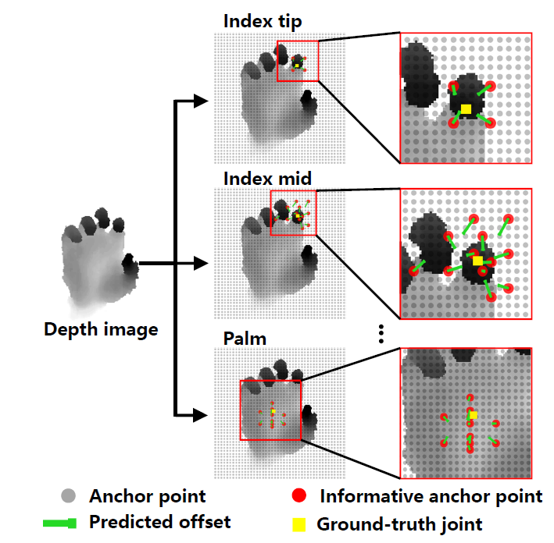
Main idea:
Anchor-to-Joint Regression Network:
Adaptive towards different joints;
2D CNN (abandon deconv);
End-to-end training.
Fast (105 fps on 1080Ti GPU).

Slide 6
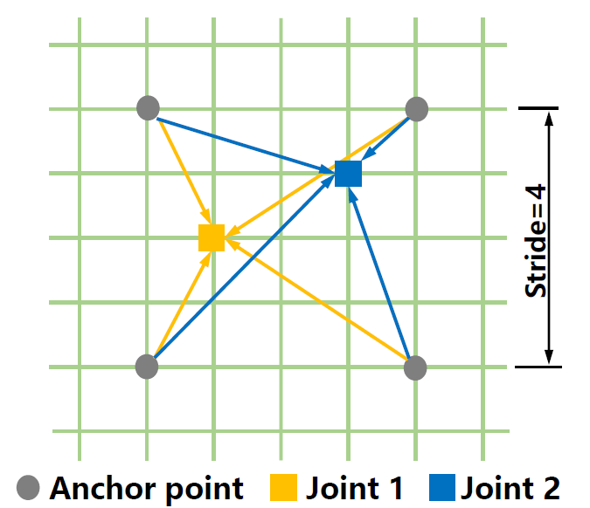
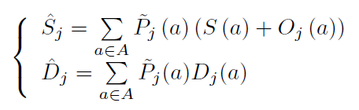
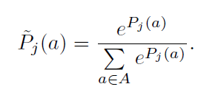
Anchor-to-Joint:
In-plain prediction
Depth
prediction
Weight assignment

Slide 7
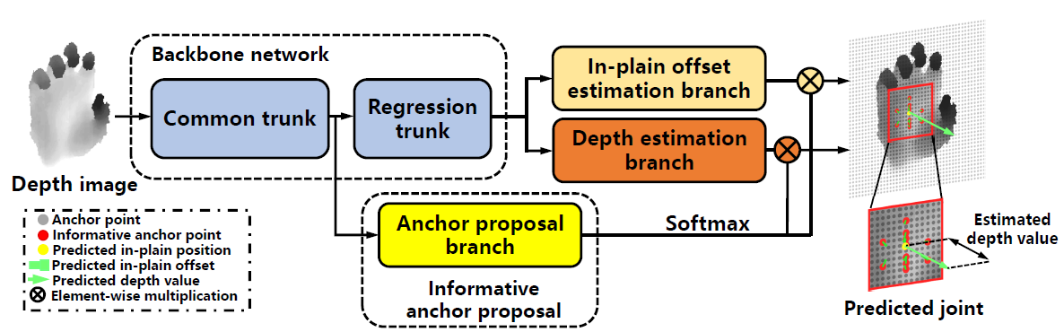
Method:
Pipeline:

Slide 8





Method:
Backbone:
Resnet50
bottleneck
spatial $×16$
$$1×1 conv$$
$$3×3, dilate 2,$$ $stride 1$
$$1×1 conv$$
$$1×1 conv$$
$$add$$
layer 1 - 3
Common trunk
layer 4
Regression branch
Set conv stride as 1
Use dilated conv

Slide 9
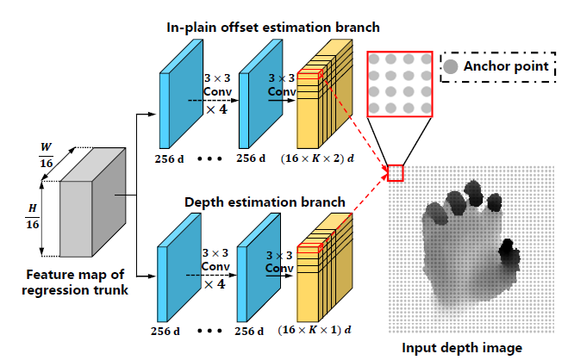
Method:
In-plain offset / depth estimation branch:

Slide 10
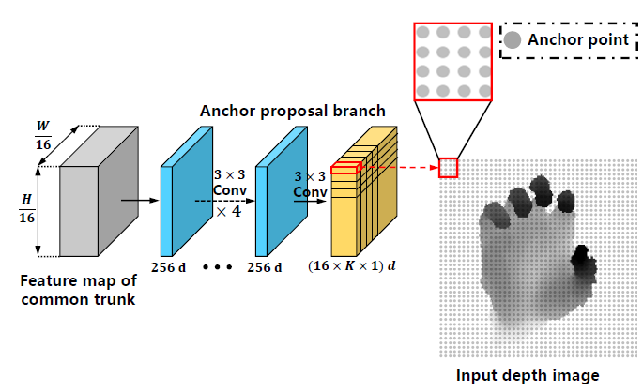
Method:
Anchor proposal branch:

Slide 11
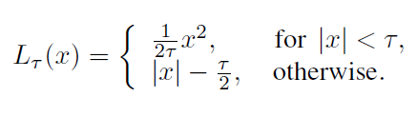
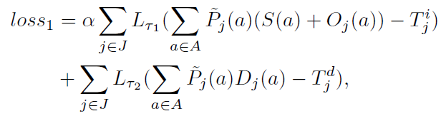
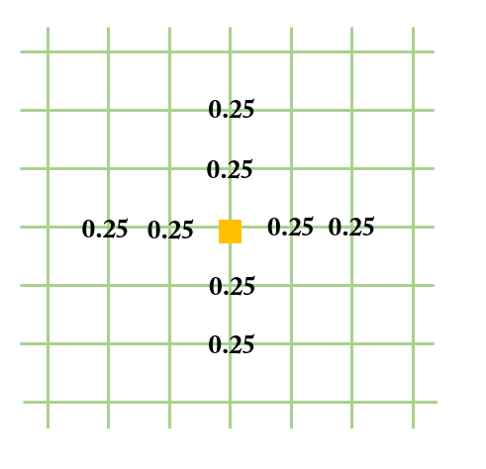
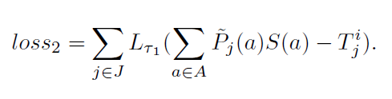
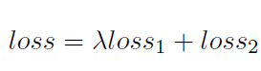
Loss:
1) Joint position estimation loss:
2) Informative anchor point surrounding loss:
3) End-to-end training:

Slide 12
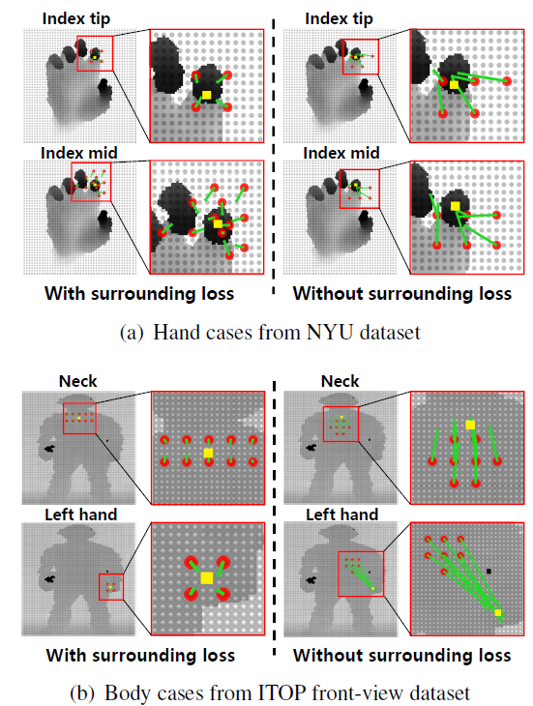
Loss:
2) Informative anchor point surrounding loss:

Slide 13
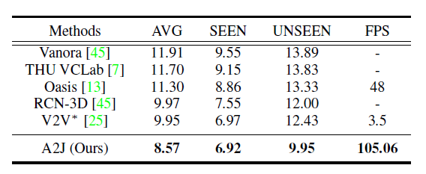
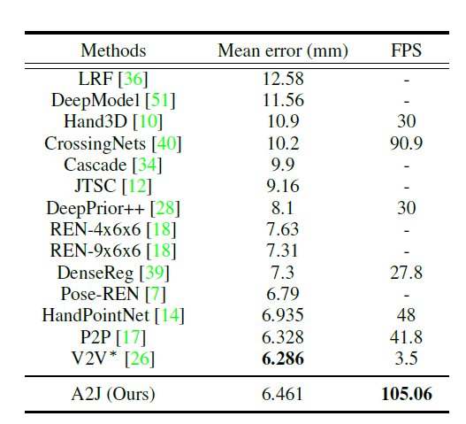
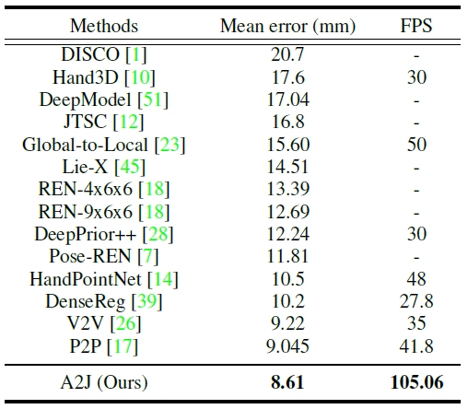
Experiments:
Comparison with state-of-the-art methods
ICVL
HANDS 2017
NYU

Slide 14
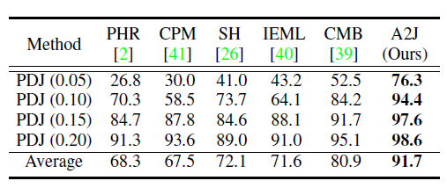
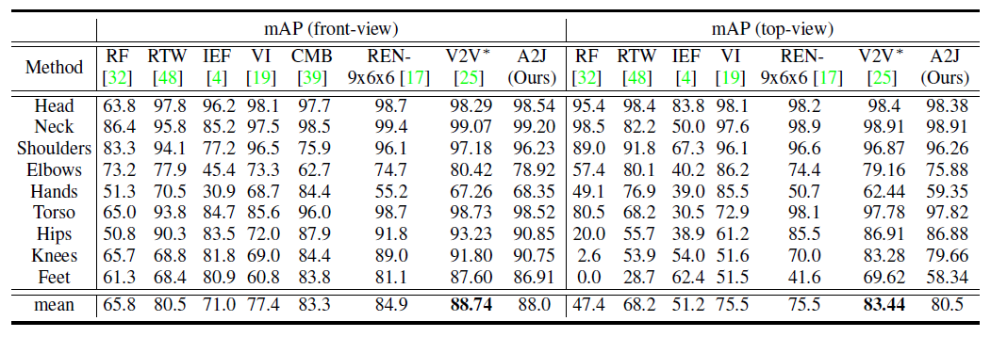
Experiments:
Comparison with state-of-the-art methods
K2HPD body pose dataset
ITOP body pose dataset

Slide 15
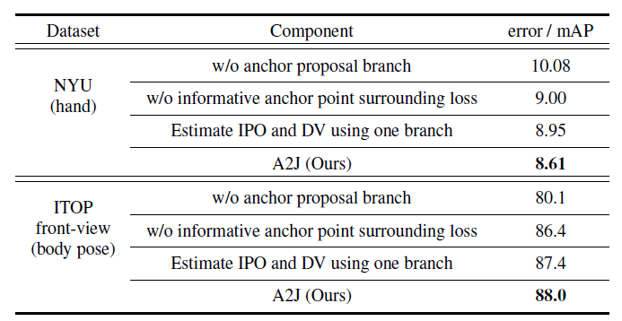
Experiments:
Ablation study
Component effectiveness analysis
Anchor point adaptivity: not all the anchor points contribute equally to the certain joints;
Informative anchor point spatial layout is an essential issue towards generalization ability;
In-plain offset and depth value holds different physical characteristics.

Slide 16
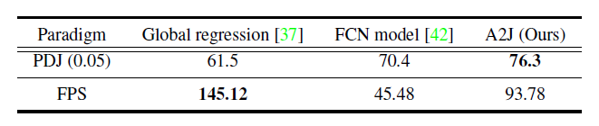
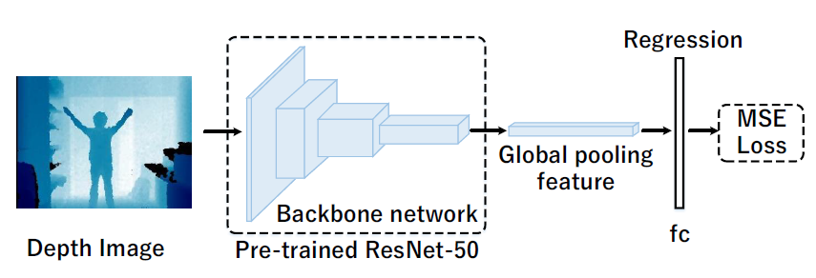
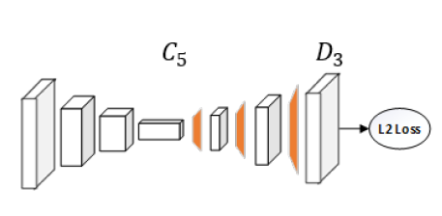
Experiments:
Ablation study
Effectiveness of anchor-based paradigm
FCN model:
Global regression:

Slide 17
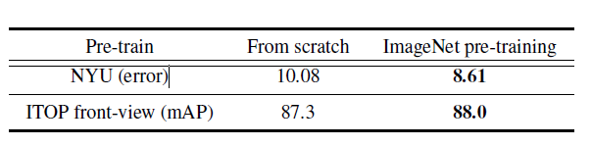
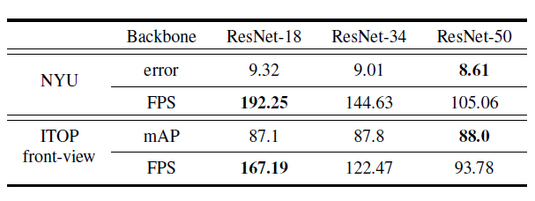
Experiments:
Ablation study
Effectiveness of the pre-training
Backbone network comparison

Slide 18
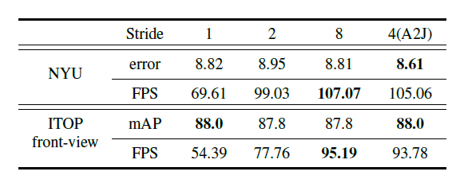
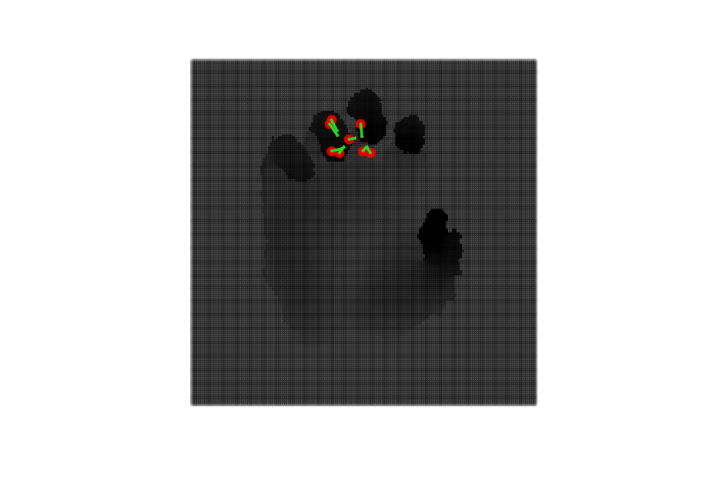
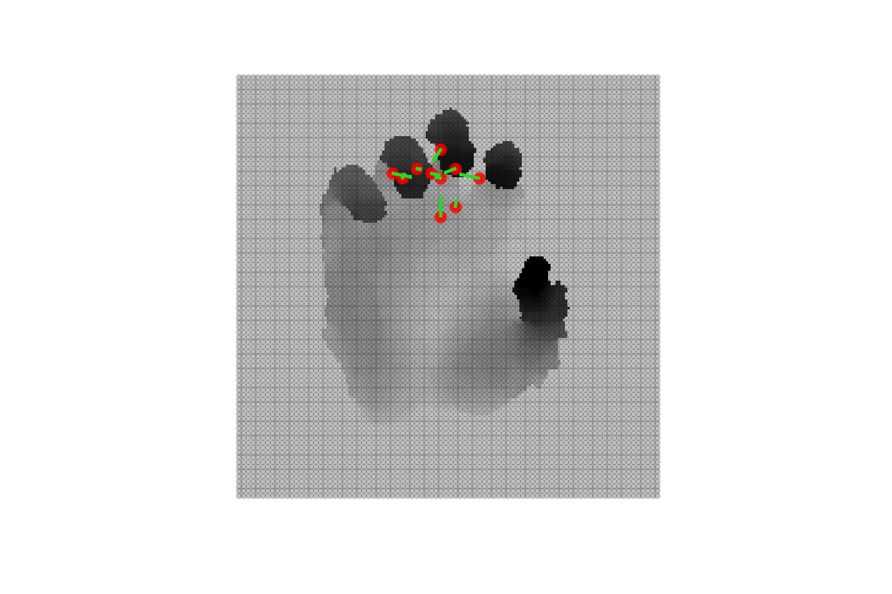
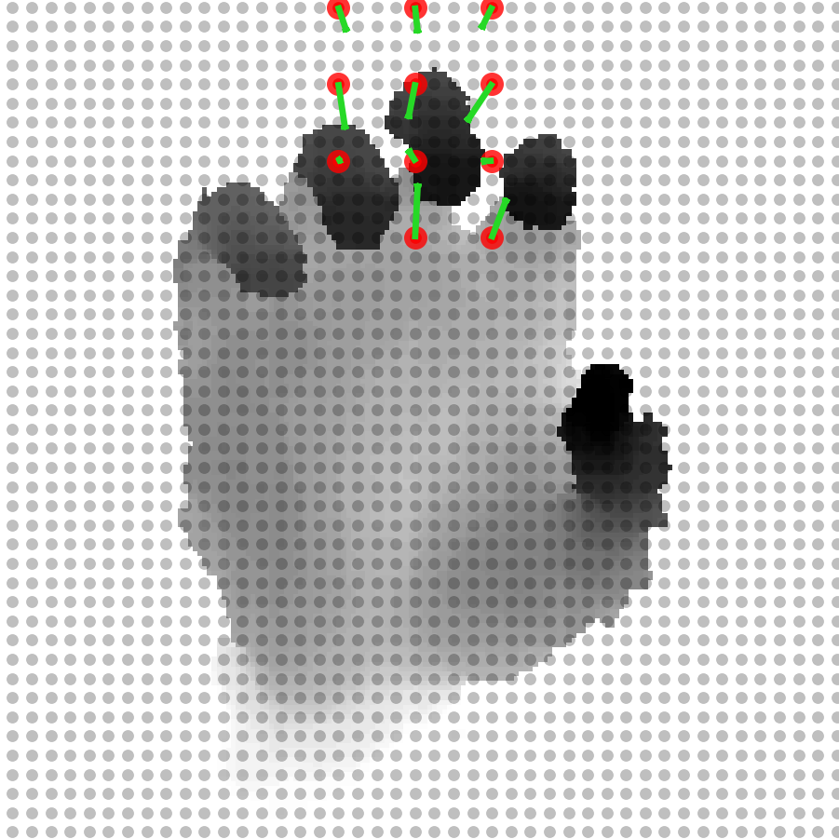
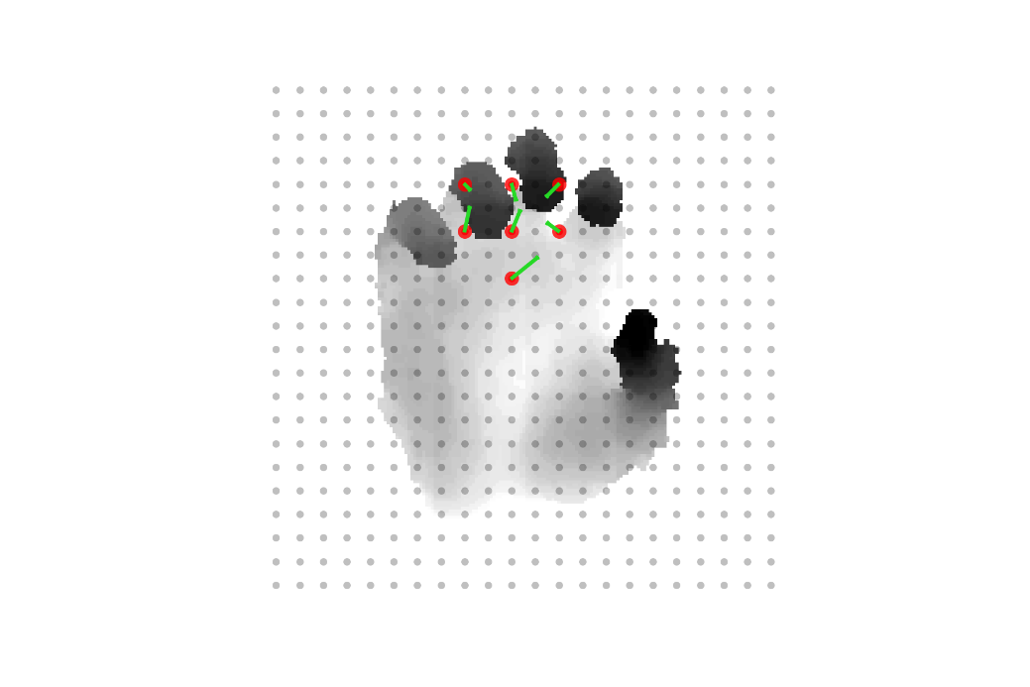
Experiments:
Ablation study
Performance comparison among the different stride
Stride 1/2/4/8, NYU hand, index tip.

Slide 19
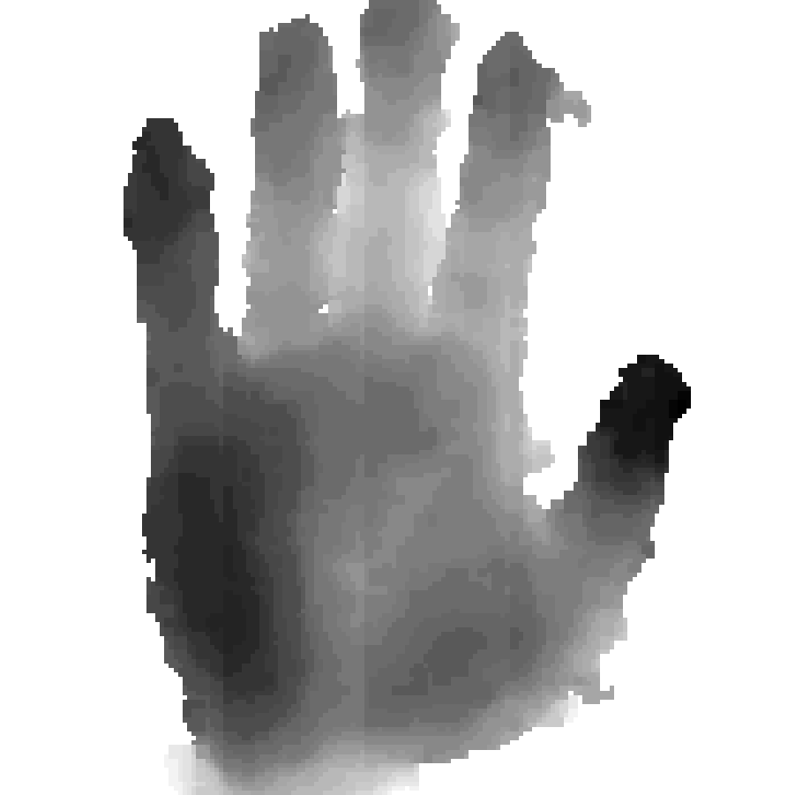
More results:
1: Input original depth image;
Pinky tip
Pinky mid
Ring tip
Ring mid
Middle tip
Middle mid
Index tip
Index mid
Thumb tip
Thumb mid
Thumb root
Wrist back
Wrist
Palm
NYU hand dataset.

Slide 20
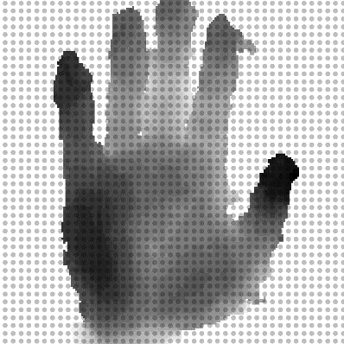
2: Densely set anchor points on depth image;
Pinky tip
Pinky mid
Ring tip
Ring mid
Middle tip
Middle mid
Index tip
Index mid
Thumb tip
Thumb mid
Thumb root
Wrist back
Wrist
Palm
NYU hand dataset.

Slide 21
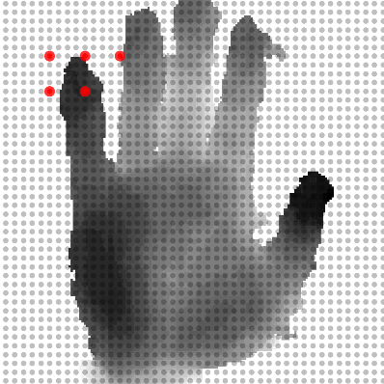
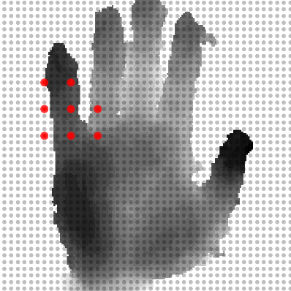
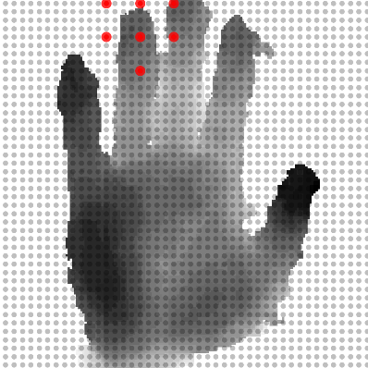
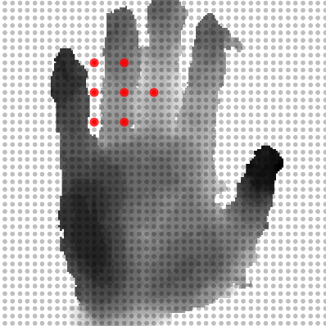
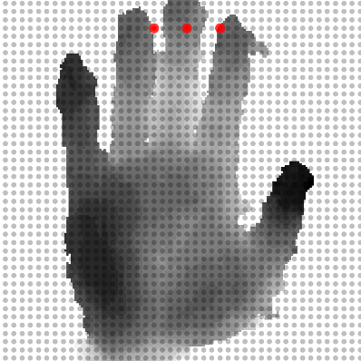


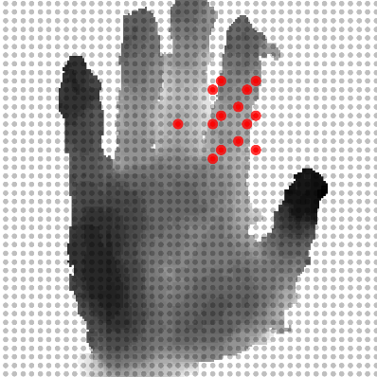
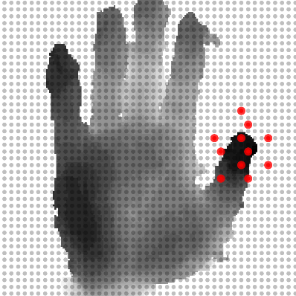
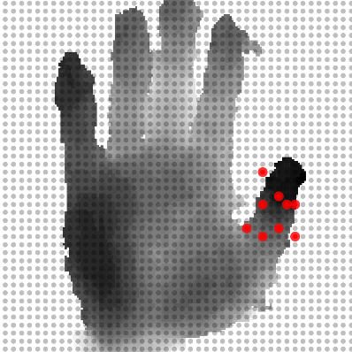
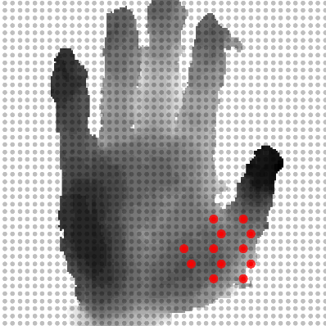
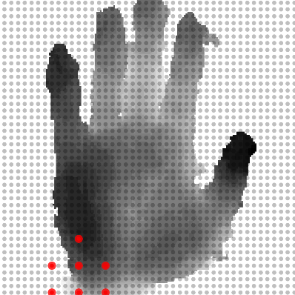
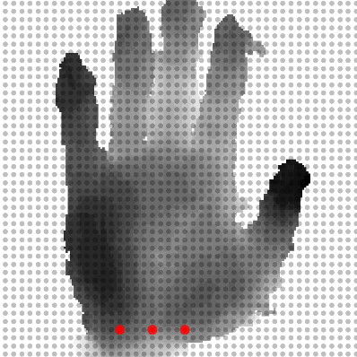
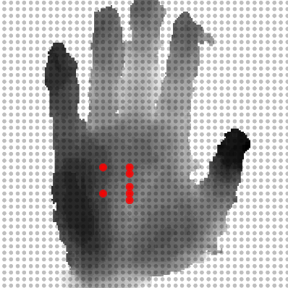
3: Discover informative anchor points;
Pinky tip
Pinky mid
Ring tip
Ring mid
Middle tip
Middle mid
Index tip
Index mid
Thumb tip
Thumb mid
Thumb root
Wrist back
Wrist
Palm
NYU hand dataset.

Slide 22
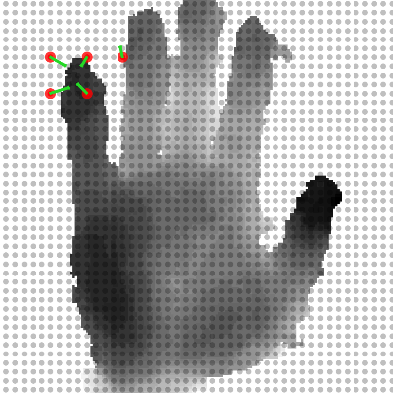

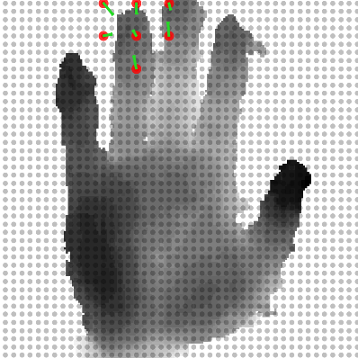





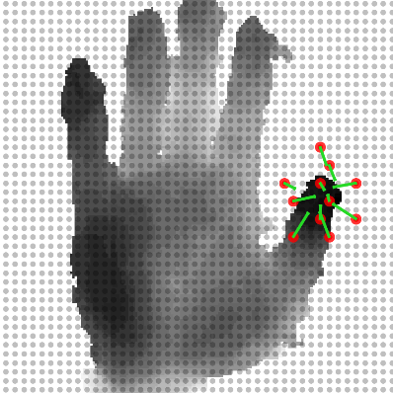





4: In-plain offset estimation.
Pinky tip
Pinky mid
Ring tip
Ring mid
Middle tip
Middle mid
Index tip
Index mid
Thumb tip
Thumb mid
Thumb root
Wrist back
Wrist
Palm
NYU hand dataset.

Slide 23

1: Input original depth image;
Pinky tip
Pinky mid
Ring tip
Ring mid
Middle tip
Middle mid
Index tip
Index mid
Thumb tip
Thumb mid
Thumb root
Wrist back
Wrist
Palm
NYU hand dataset.

Slide 24

2: Densely set anchor points on depth image;
Pinky tip
Pinky mid
Ring tip
Ring mid
Middle tip
Middle mid
Index tip
Index mid
Thumb tip
Thumb mid
Thumb root
Wrist back
Wrist
Palm
NYU hand dataset.

Slide 25














3: Discover informative anchor points;
Pinky tip
Pinky mid
Ring tip
Ring mid
Middle tip
Middle mid
Index tip
Index mid
Thumb tip
Thumb mid
Thumb root
Wrist back
Wrist
Palm
NYU hand dataset.

Slide 26














4: In-plain offset estimation.
Pinky tip
Pinky mid
Ring tip
Ring mid
Middle tip
Middle mid
Index tip
Index mid
Thumb tip
Thumb mid
Thumb root
Wrist back
Wrist
Palm
NYU hand dataset.

Slide 27

1: Input original depth image;
Head
Neck
RShoulder
LShoulder
RElbow
LElbow
RHand
LHand
RHip
LHip
RKnee
LKnee
RFoot
LFoot
ITOP front-view body dataset.

Slide 28

2: Densely set anchor points on depth image;
Head
Neck
RShoulder
LShoulder
RElbow
LElbow
RHand
LHand
RHip
LHip
RKnee
LKnee
RFoot
LFoot
ITOP front-view body dataset.

Slide 29














3: Discover informative anchor points;
Head
Neck
RShoulder
LShoulder
RElbow
LElbow
RHand
LHand
RHip
LHip
RKnee
LKnee
RFoot
LFoot
ITOP front-view body dataset.

Slide 30














4: In-plain offset estimation.
Head
Neck
RShoulder
LShoulder
RElbow
LElbow
RHand
LHand
RHip
LHip
RKnee
LKnee
RFoot
LFoot
ITOP front-view body dataset.

Slide 31
2. Qualitative results (3D pose estimation).
NYU hand dataset.

Slide 32
2. Qualitative results (3D pose estimation).
NYU hand dataset.

Slide 33
2. Qualitative results (3D pose estimation).
ITOP front-view body dataset.

Slide 34
2. Qualitative results (3D pose estimation).
ITOP front-view body dataset.

Slide 35


Reviews:

Slide 36
Thanks for
your attention!

